Slide 1

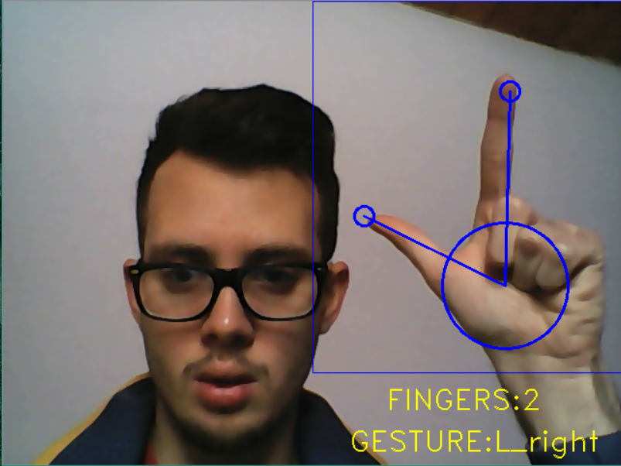
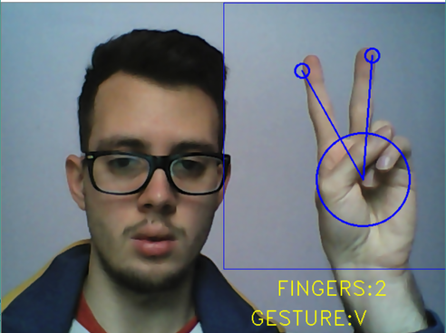

Object manipulation using
finger tip tracking
Introduction
Filtering
Detect palm and mark fingers
We need to detect hand palm and with respect to it to do finger tips detection.
First we go counter clockwise direction and eliminate all convex hull points that are very near to each other. This helps in achieving ‘1 point per finger’.
Eliminate all convex hull points too far or too near the hand center . This will leave us with just a single point per every finger that is stretched out.
We now have a palm center, radius and exactly only those many points in a convex hull that belong to our fingers. The plus point is, we have proper coordinates of each and every finger after this function.
Hand Gestures
Every gesture contains : name of gesture, list of finger position, palm center location and angle between each finger and X axis. At beginning of project we declare dictionary of gestures. Every time the hand recognition code is run and every time we have a new coordinate for our hand and fingers, we update the attributes of this instance.
Gesture comparison first check if number of fingers is the same as gesture in dictionary. If the number of fingers are same , we generate an array of differences in angles made by each finger for gestures we compare. If the values turn out to be nearly constant , the gestures are probably the same.
Concussion
The main accent of this project was the hand and gesture recognition. During work , a lot of algorithms for skin detection were tried. The one with histogram proved to work the best.
Still the program doesn’t have good performance if ambient is too bright or to dark , and hand detection isn’t so correct. In future times I’ll try to correct this problems.
Lets start this preview by explaining the term of augmented reality.
Augmented reality is the integration of digital information with the user's environment in real time. Unlike virtual reality, which creates a totally artificial environment, augmented reality uses the existing environment and overlays new information on top of it. This project demonstrates the idea of using webcam to recognize hand gesture and to rotate 3D cube for given hand gesture. Project could help any newcomer to get acquainted with basic concept of augmented reality .
Background subtraction
This is the first part of this program. This will help reduce detection of false stationary objects which are around the same histogram range as user hand.
For every image taken we first apply bilateral filtering to remove noise while keeping edges sharp. Now using the Gaussian mixture model background subtraction, we create the background model from input frame. Later the same model will be used for distinction between skin color and background.
Hand histogram
Now that we have a plain background image detected, we go for capturing a histogram of our hand that we need the program to recognize in each frame. For this the user moves his hand to cover the 9 small boxes in such a way that all or most of his hand shades are covered in them with no air gaps or dark shadows on it. This step is very necessary for a proper recognition.
For taking histogram , we must take a couple of steps:
We must convert image frame to HSV color model. The reason for this is: that HSV model is lesser affected by lighting and color information is easier extracted.
2. Histogram is created from given pixel values
Will create the mask using background model. Then this mask will be applied to input frame , to get frame containing only foreground.
Then we proceed to searching for hand using the histogram we generated.
First we blur the image frame to reduce noice using median blur
Then frame is converted to HSV color space
Calculate back projection of image using function from cv2 library. The histogram generated previously is passed as a parameter to this function call.
Apply morphology and smoothening techniques (Gaussian and Median blur) to the back projection generated.
Apply threshold to generate a binary image from the back projection. This threshold is used as a mask to separate out the hand from the rest of the frame.
Finding convex Hull
Contours are a curve joining all the continuous points, having same color or intensity. We user opencv to find all contours , and then we find the biggest – to verify is it a hand.
If that is a hand : we find the convex Hull. Generally speaking, convex curves are the curves which are always bulged out, or at-least flat. We will use them to detect finger tips and hand palm.

